Slide 1
Convolutional Sequence to Sequence Learning
Facebook AI Research
DaSE 崔屹峰

Slide 2
Overview
Note
Convolutional Block Structure
Contrast
Experiments
Conclusion

Slide 3
Overview
Note
Convolutional Block Structure
Contrast
Experiments
Conclusion

Slide 4
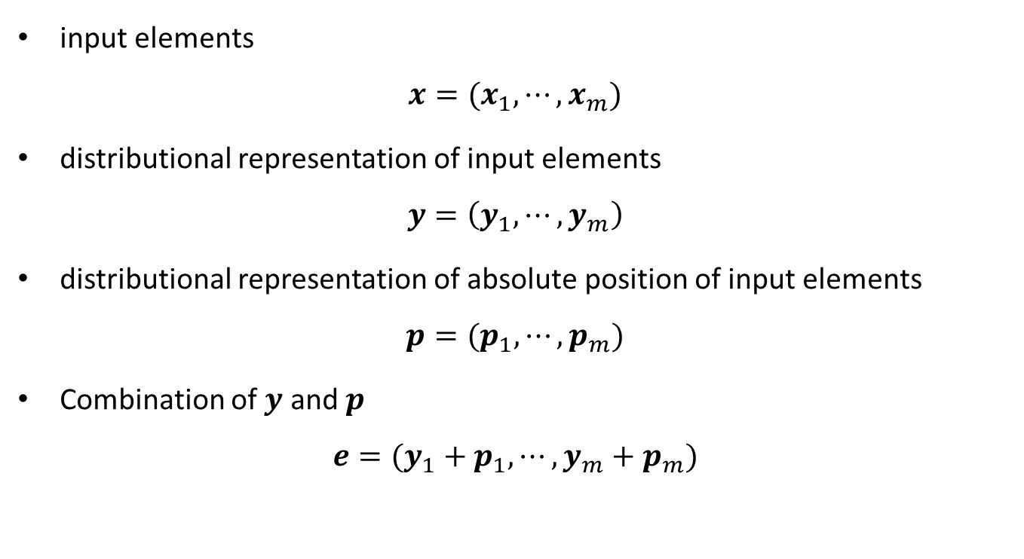
Note
input elements
$$x=(x_{1},⋯,x_{m})$$
distributional representation of input elements
$$y=\left(y_{1},⋯,y_{m}\right)$$
distributional representation of absolute position of input elements
$$p=(p_{1},⋯,p_{m})$$
Combination of $y$ and $p$
$$e=(y_{1}+p_{1},⋯,y_{m}+p_{m})$$

Slide 5
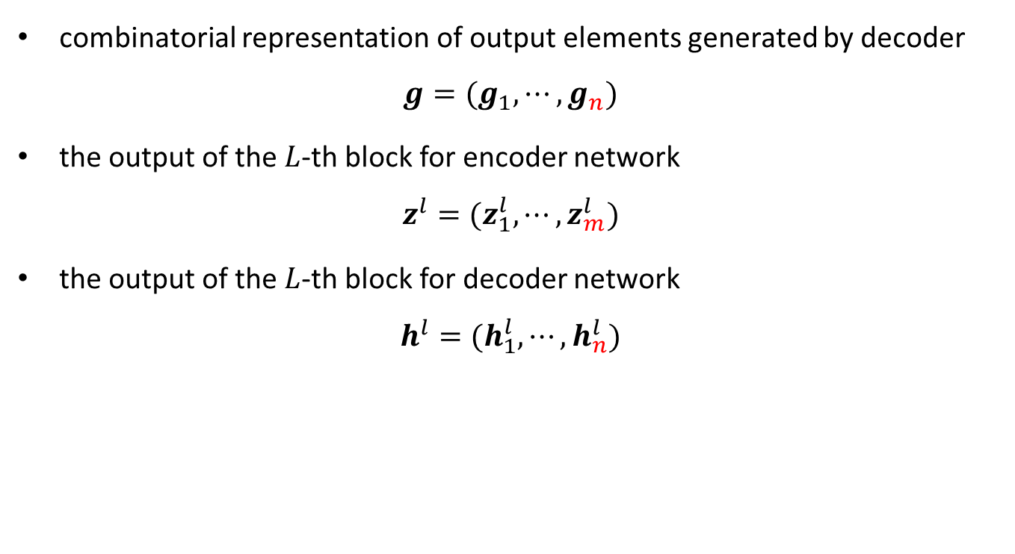
Note cont.
combinatorial representation of output elements generated by decoder
$$g=(g_{1},⋯,g_{n})$$
the output of the $L$-th block for encoder network
$$z_{}^{l}=(z_{1}^{l},⋯,z_{m}^{l})$$
the output of the $L$-th block for decoder network
$$h_{}^{l}=(h_{1}^{l},⋯,h_{n}^{l})$$

Slide 6
Overview
Note
Convolutional Block Structure
Contrast
Experiments
Conclusion

Slide 7
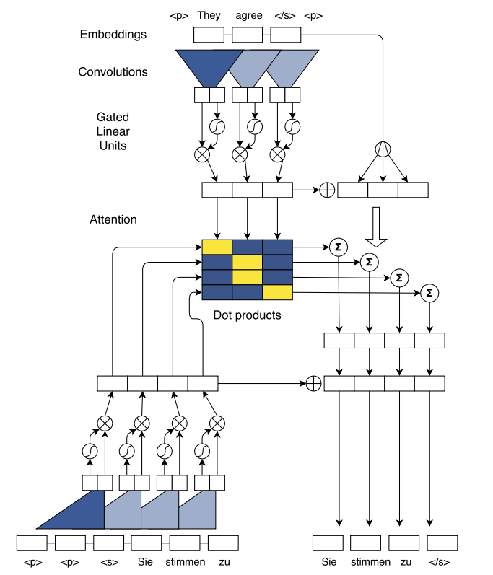
A Convolutional Architecture
Illustration of batching during training

Slide 8
A Convolutional Architecture
The encoder contains a series of convolutional blocks which consist of Conv1D, GLU and residual connection.
The main architecture of the decoder is similar to the encoder’s.
Illustration of batching during training

Slide 9


A Convolutional Architecture
$$e$$
Word embedding + Position embedding
$$g$$
Illustration of batching during training

Slide 10
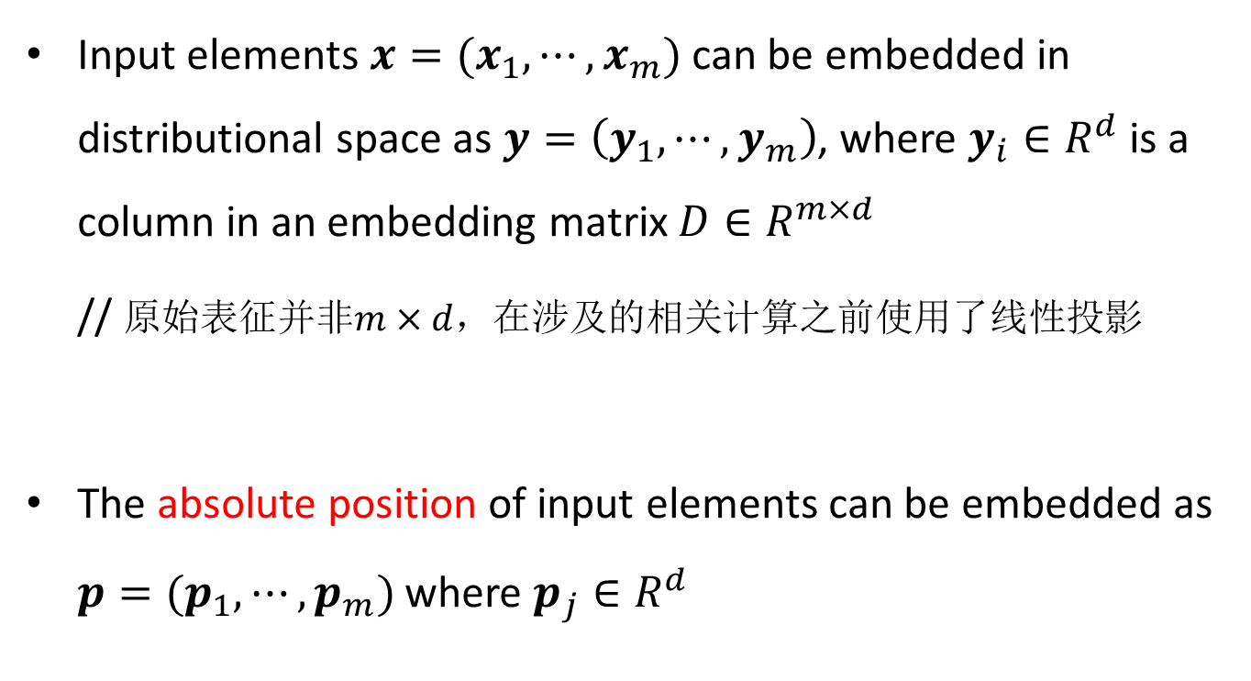
Position Embedding
Input elements $x=(x_{1},⋯,x_{m})$ can be embedded in distributional space as $y=\left(y_{1},⋯,y_{m}\right)$, where $y_{i}∈R^{d}$ is a column in an embedding matrix $D∈R^{m×d}$
// 原始表征并非$m×d$，在涉及的相关计算之前使用了线性投影
The absolute position of input elements can be embedded as $p=(p_{1},⋯,p_{m})$ where $p_{j}∈R^{d}$

Slide 11
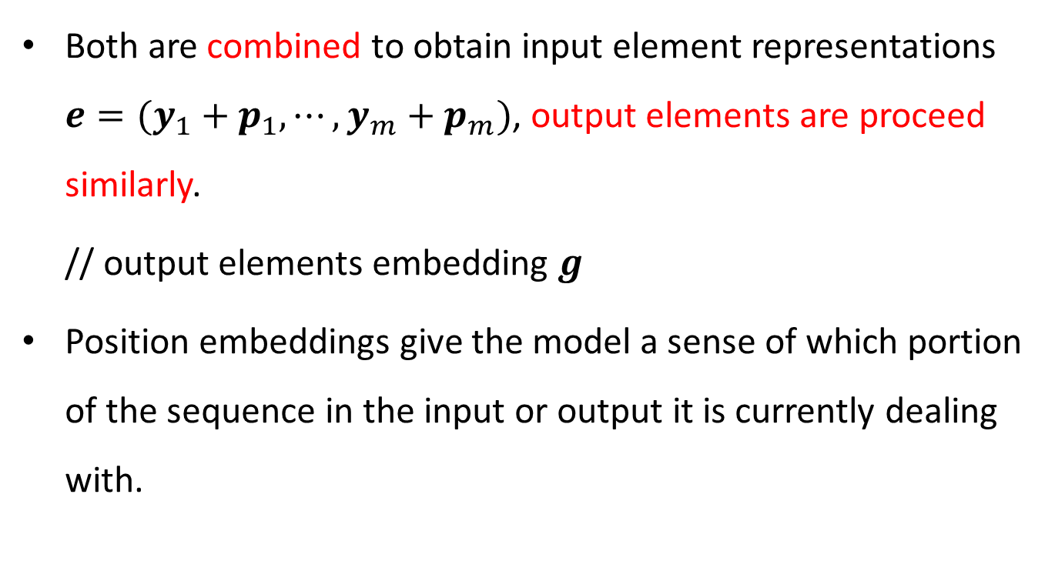
Position Embedding cont.
Both are combined to obtain input element representations $e=(y_{1}+p_{1},⋯,y_{m}+p_{m})$, output elements are proceed similarly.
// output elements embedding $g$
Position embeddings give the model a sense of which portion of the sequence in the input or output it is currently dealing with.

Slide 12

A Convolutional Architecture
The kernel size of Conv1D is $2d×kd$.
Corresponding kernel size of Conv2D is $2d×k×d$.
Illustration of batching during training

Slide 13
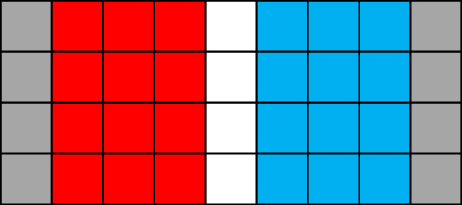
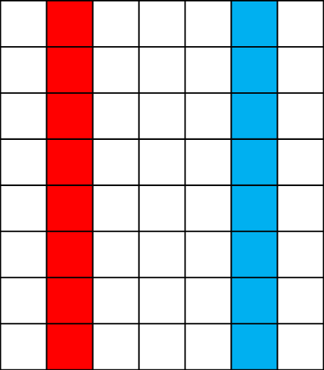

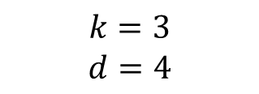
$$h^{l−1}(or z^{l−1}) with padding=1$$
$$k=3$$
$$d=4$$

Slide 14
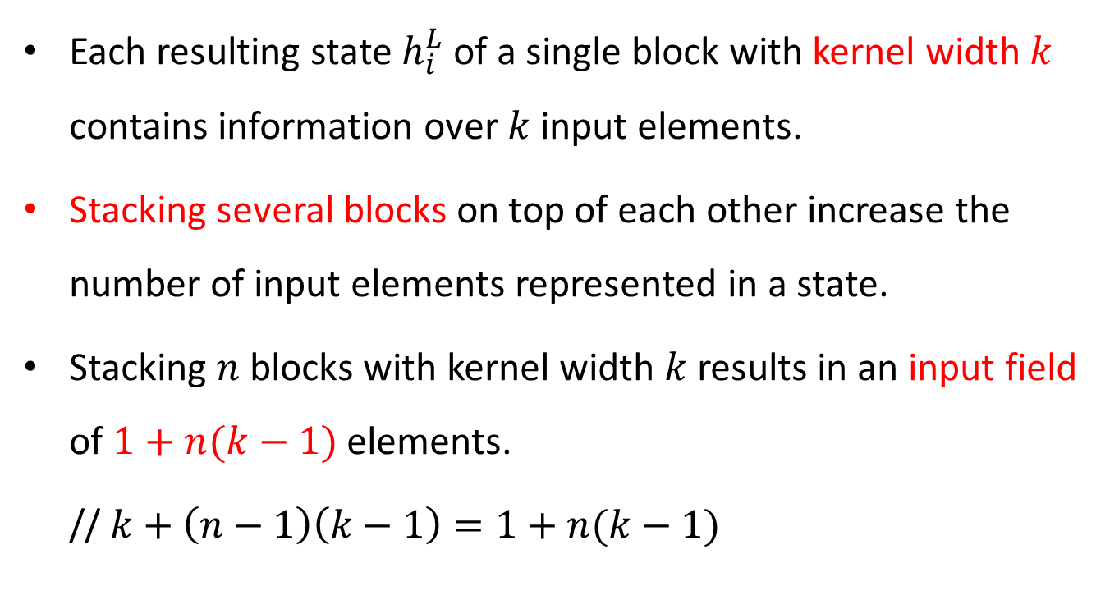
Input field of Convolution
Each resulting state $h_{i}^{L}$ of a single block with kernel width $k$ contains information over $k$ input elements.
Stacking several blocks on top of each other increase the number of input elements represented in a state.
Stacking $n$ blocks with kernel width $k$ results in an input field of $1+n(k−1)$ elements.
// $k+\left(n−1\right)\left(k−1\right)=1+n(k−1)$

Slide 15
A Convolutional Architecture
GLU allows the model to select which words or features are relevant for the next prediction.
Illustration of batching during training

Slide 16
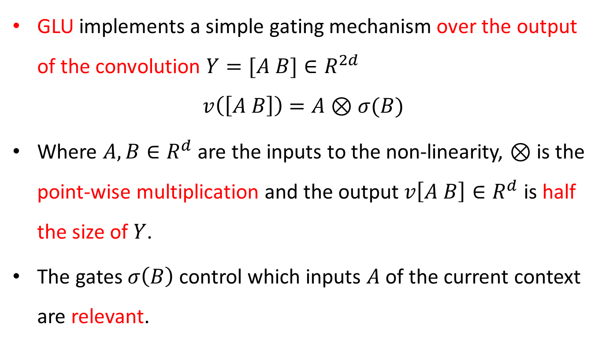
Gated Linear Unit(GLU)
GLU implements a simple gating mechanism over the output of the convolution $Y=[A B]∈R^{2d}$
$$v\left(\left[A B\right]\right)=A⊗σ(B)$$
Where $A,B∈R^{d}$ are the inputs to the non-linearity, $⊗$ is the point-wise multiplication and the output $v\left[A B\right]∈R^{d}$ is half the size of $Y$.
The gates $σ\left(B\right)$ control which inputs $A$ of the current context are relevant.

Slide 17
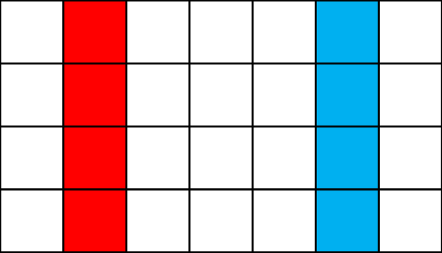

$$h^{L−1}(or z^{L−1}) with padding=1$$
GLU

Slide 18
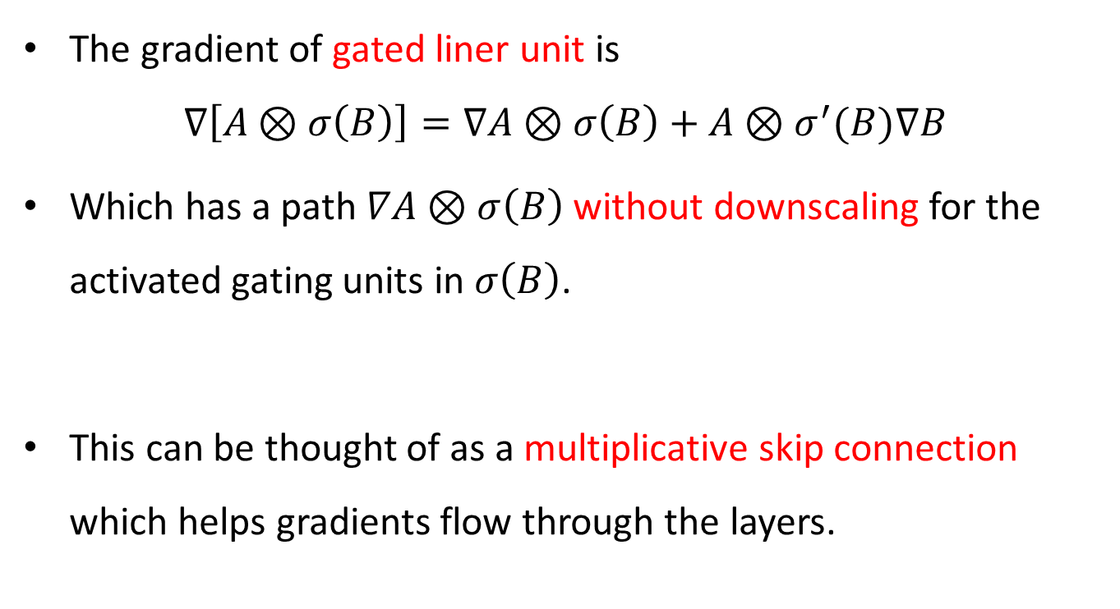
GLU cont.
The gradient of gated liner unit is
$$∇\left[A⊗σ\left(B\right)\right]=∇A⊗σ\left(B\right)+A⊗σ^{′}(B)∇B$$
Which has a path $∇A⊗σ\left(B\right)$ without downscaling for the activated gating units in $σ\left(B\right)$.
This can be thought of as a multiplicative skip connection which helps gradients flow through the layers.

Slide 19
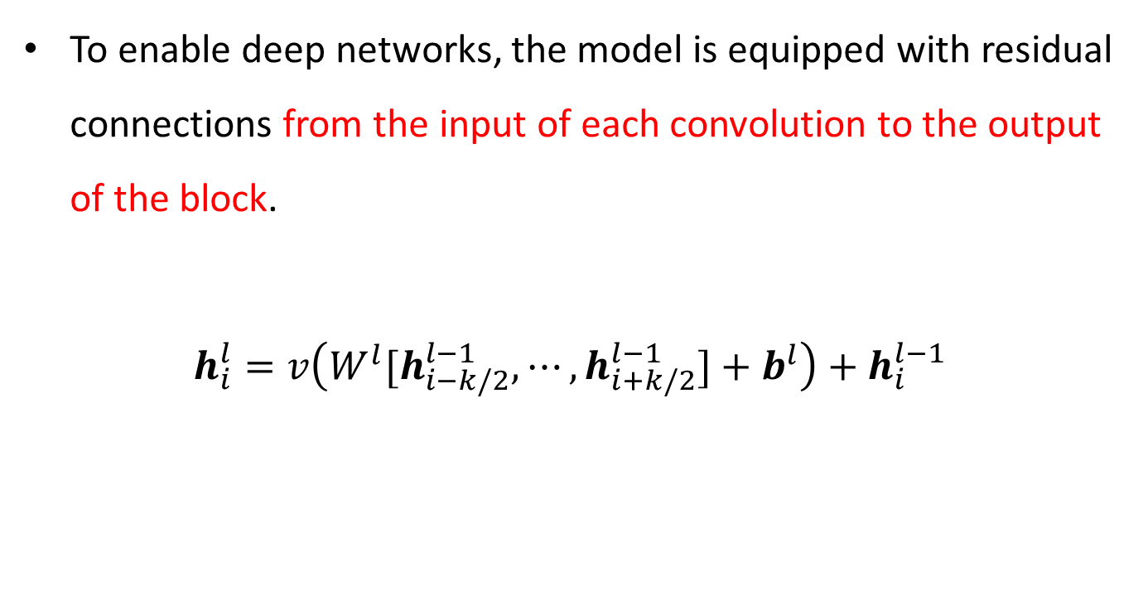
Residual Connection
To enable deep networks, the model is equipped with residual connections from the input of each convolution to the output of the block.
$$h_{i}^{l}=v\left(W^{l}[h_{i−k/2}^{l−1},⋯,h_{i+k/2}^{l−1}]+b_{}^{l}\right)+h_{i}^{l−1}$$

Slide 20
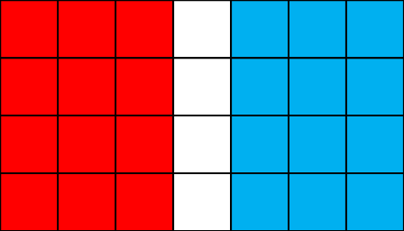


$$h^{l−1}(or z^{l−1}) with padding=1$$
$$h^{l}(or z^{l})$$
+
Res Conn
GLU

Slide 21







A Convolutional Architecture
$$z^{u}$$
$$a^{l}$$
$$z^{u}+e$$
$$d^{l}$$
$$c^{l}$$
$$h^{l}$$
$$h^{l}+c^{l}$$
Illustration of batching during training

Slide 22








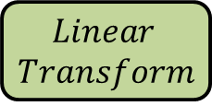





$$z_{}^{u}$$
$$Dot$$
$$Products$$
$$d_{}^{l}$$
$$a_{}^{l}$$
$$Attention$$
$$z_{}^{u}+e$$
$$g$$
$$Linear$$
$$Transform$$
$$c_{}^{l}$$
$$h_{}^{l}$$
$$+$$
$$ResBlock$$
$$h_{}^{l−1}+c^{l−1}$$
$$h_{}^{l}+c^{l}$$
A decoder block with multi-step attention

Slide 23
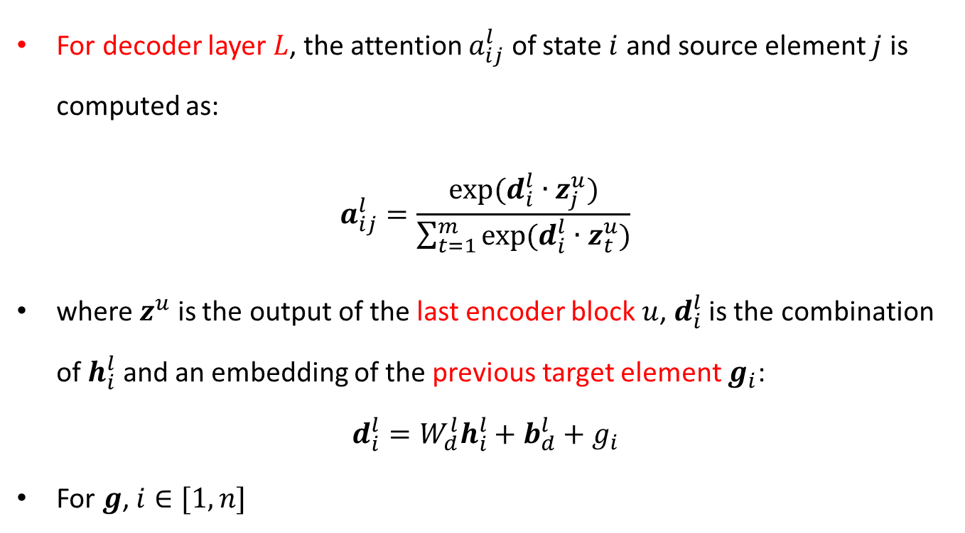
Multi-step Attention
For decoder layer $L$, the attention $a_{ij}^{l}$ of state $i$ and source element $j$ is computed as:
$$a_{ij}^{l}=\frac{exp⁡(d_{i}^{l}∙z_{j}^{u})}{\sum_{t=1}^{m}{exp⁡(d_{i}^{l}∙z_{t}^{u})}}$$
where $z^{u}$ is the output of the last encoder block $u$, $d_{i}^{l}$ is the combination of $h_{i}^{l}$ and an embedding of the previous target element $g_{i}$:
$$d_{i}^{l}=W_{d}^{l}h_{i}^{l}+b_{d}^{l}+g_{i}$$
For $g$, $i∈[1,n]$

Slide 24


$$z_{}^{u}$$
$$Dot$$
$$Products$$
$$d_{}^{l}$$
$$a_{}^{l}$$
$$Attention$$
$$z_{}^{u}+e$$
$$g$$
$$Linear$$
$$Transform$$
$$c_{}^{l}$$
$$h_{}^{l}$$
$$+$$
$$ResBlock$$
$$h_{}^{l−1}+c^{l−1}$$
$$h_{}^{l}+c^{l}$$
A decoder block with multi-step attention

Slide 25
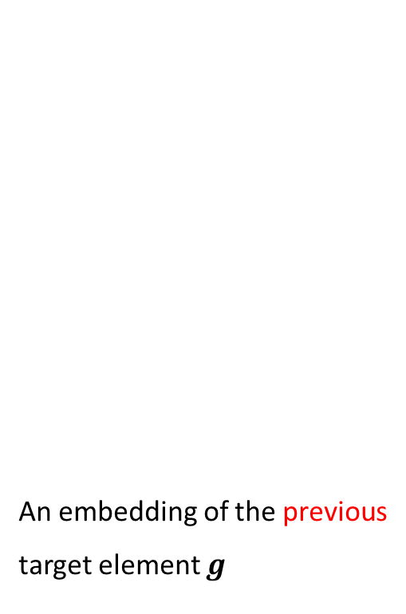
A Convolutional Architecture
An embedding of the previous target element $g$
$$z^{u}$$
$$a^{l}$$
$$z^{u}+e$$
$$d^{l}$$
$$c^{l}$$
$$h^{l}$$
$$h^{l}+c^{l}$$
Illustration of batching during training

Slide 26
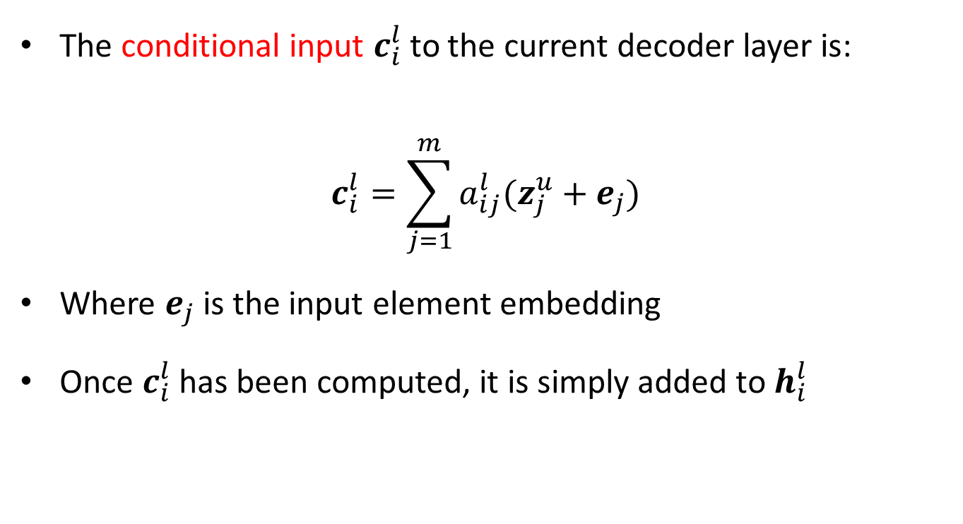
Multi-step Attention cont.
The conditional input $c_{i}^{l}$ to the current decoder layer is:
$$c_{i}^{l}=\sum_{j=1}^{m}{a_{ij}^{l}(z_{j}^{u}+e_{j})}$$
Where $e_{j}$ is the input element embedding
Once $c_{i}^{l}$ has been computed, it is simply added to $h_{i}^{l}$

Slide 27



$$z_{}^{u}$$
$$Dot$$
$$Products$$
$$d_{}^{l}$$
$$a_{}^{l}$$
$$Attention$$
$$z_{}^{u}+e$$
$$g$$
$$Linear$$
$$Transform$$
$$c_{}^{l}$$
$$h_{}^{l}$$
$$+$$
$$ResBlock$$
$$h_{}^{l−1}+c^{l−1}$$
$$h_{}^{l}+c^{l}$$
A decoder block with multi-step attention

Slide 28
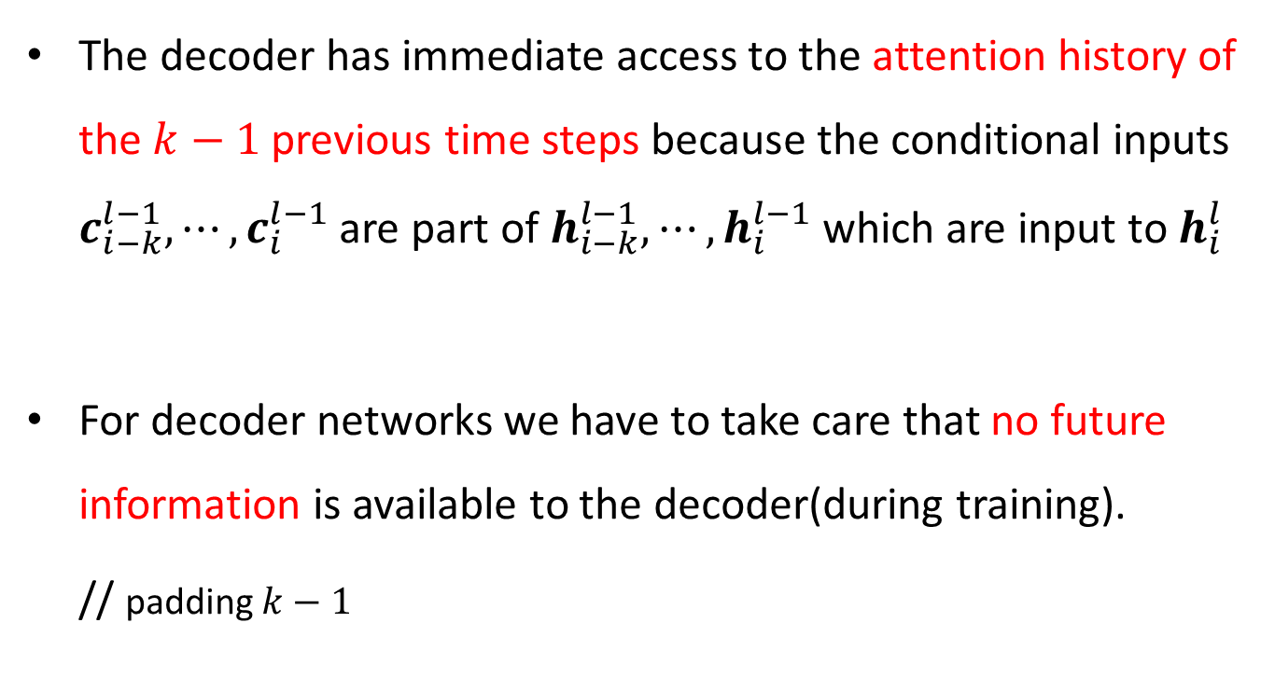
Multi-step Attention cont.
The decoder has immediate access to the attention history of the $k−1$ previous time steps because the conditional inputs $c_{i−k}^{l−1},⋯,c_{i}^{l−1}$ are part of $h_{i−k}^{l−1},⋯,h_{i}^{l−1}$ which are input to $h_{i}^{l}$
For decoder networks we have to take care that no future information is available to the decoder(during training).
// padding $k−1$

Slide 29

A Convolutional Architecture
Padding the input by $k−1$ elements on the left.
// $k=3$
$$z^{u}$$
$$a^{l}$$
$$z^{u}+e$$
$$d^{l}$$
$$c^{l}$$
$$h^{l}$$
$$h^{l}+c^{l}$$
Illustration of batching during training

Slide 30
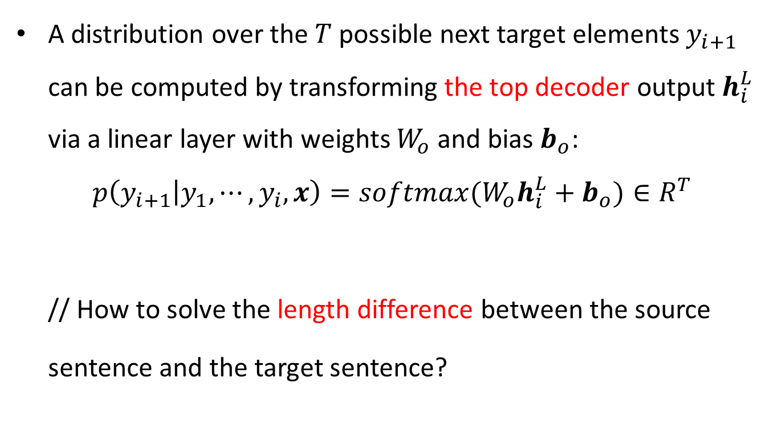
Output Distribution
A distribution over the $T$ possible next target elements $y_{i+1}$ can be computed by transforming the top decoder output $h_{i}^{L}$ via a linear layer with weights $W_{o}$ and bias $b_{o}$:
$$p\left(y_{i+1} | y_{1},⋯,y_{i},x\right)=softmax(W_{o}h_{i}^{L}+b_{o})∈R^{T}$$
// How to solve the length difference between the source
sentence and the target sentence?

Slide 31
Overview
Note
Convolutional Block Structure
Contrast
Experiments
Conclusion

Slide 32
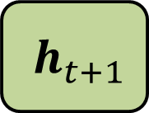

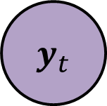
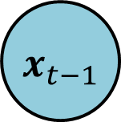

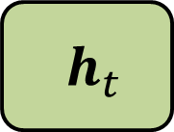
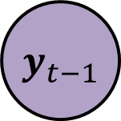

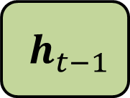
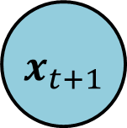
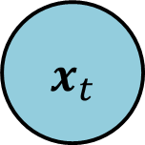
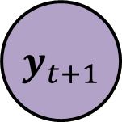
Recurrent Networks
time step $t−1$
time step $t$
time step $t+1$
$${ y}_{t−1}$$
$${ y}_{t}$$
$${ y}_{t+1}$$
$${ h}_{t−1}$$
$${ h}_{t}$$
$${ h}_{t+1}$$
$${ x}_{t−1}$$
$${ x}_{t}$$
$${ x}_{t+1}$$
The inference of a sample $x$ in RNNs. $t∈[1,m]$

Slide 33

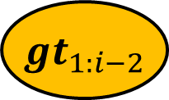
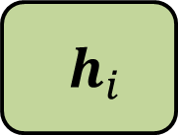
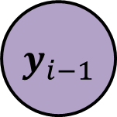

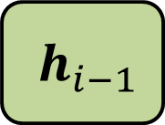
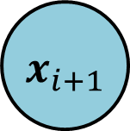
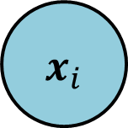
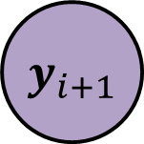
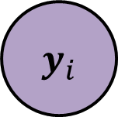
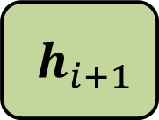
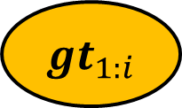
ConvSeq2Seq Networks
$${ gt}_{1:i−2}$$
$${ gt}_{1:i−1}$$
$${ gt}_{1:i}$$
$${ y}_{i−1}$$
$${ y}_{i}$$
$${ y}_{i+1}$$
$${ h}_{i−1}$$
$${ h}_{i}$$
$${ h}_{i+1}$$
$${ x}_{i−1}$$
$${ x}_{i}$$
$${ x}_{i+1}$$
The inferences of a sample $x$ in ConvS2S during training.

Slide 34
ConvSeq2Seq Networks cont.
The inferences of a sample $x$ in ConvS2S during test.

Slide 35
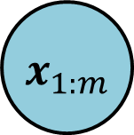

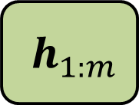
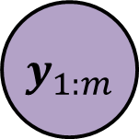

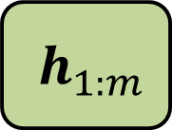

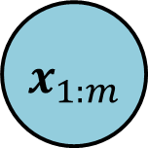

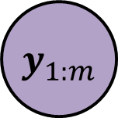


AllParallelConvSeq2Seq Networks
epoch $k−1$
epoch $k$
epoch $k+1$
$${ y}_{1:m}$$
$${ y}_{1:m}$$
$${ y}_{1:m}$$
$${ h}_{1:m}$$
$${ h}_{1:m}$$
$${ h}_{1:m}$$
$${ x}_{1:m}$$
$${ x}_{1:m}$$
$${ x}_{1:m}$$
The inferences of a sample $x$ in AP-ConvS2S during each epoch.

Slide 36
Overview
Note
Convolutional Block Structure
Contrast
Experiments
Conclusion

Slide 37
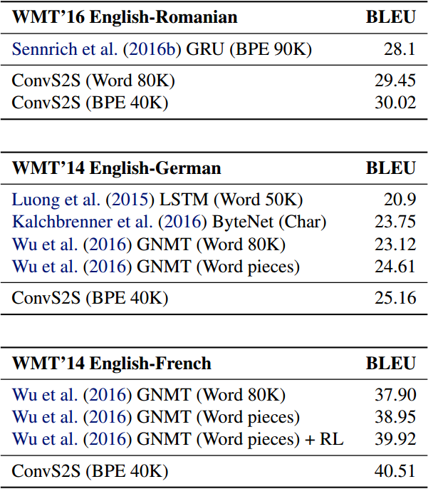
Recurrent vs. Convolutional Models
Accuracy on WMT tasks compared to previous work

Slide 38
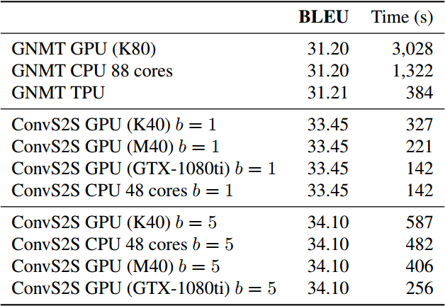
Generation Speed
CPU and GPU generation speed in seconds on the development set of WMT’14 English-French
Notes:
Beam search

Slide 39

Position Embedding
Effect of removing position embedding

Slide 40

Multi-step Attention
Multi-step attention in all five decoder layers or fewer layers in terms of validation perplexity (PPL) and test BLEU

Slide 41
Overview
Note
Convolutional Block Structure
Contrast
Experiments
Conclusion

Slide 42
Conclusion
ConvS2S is the first fully convolutional model for sequence to sequence learning that outperforms strong recurrent models on very large benchmark datasets at an order of magnitude faster speed.
Computations over all elements can be fully parallelized during training.

Slide 43
Any question?

